Slide 1


dibimbing.id
DATA
SCIENCE
Machine Learning (Classification) Implementation using a Dataset digits
from Scikit-Learn
PRESENTED BY
AZ-ZAHRA INTAN

Slide 2


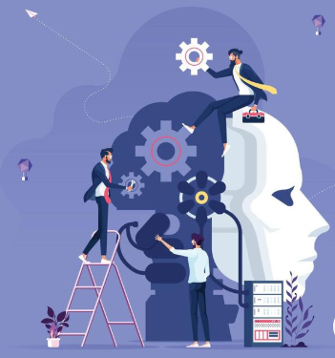



dibimbing.id
Machine Learning
Machine Learning is a branch of Artificial Intelligence that enables computers to learn from data and make decisions or predictions without being explicitly programmed. In machine learning, algorithms are used to find patterns in data and use those patterns to solve problems or make predictions based on new data.
Write your topic here

Slide 3
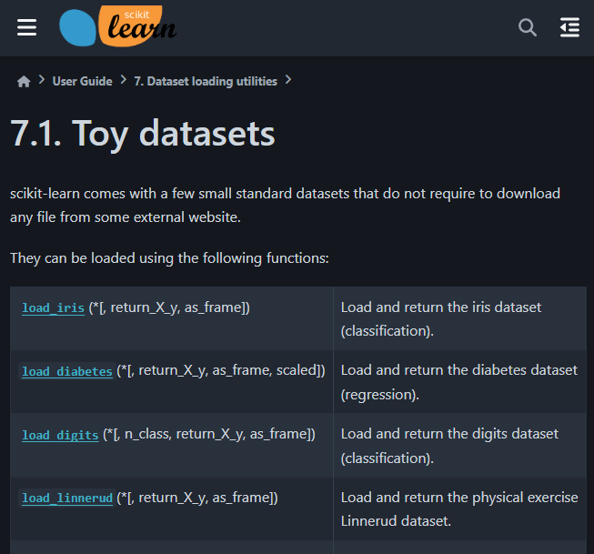

dibimbing.id
Data Set
Scikit-learn is one of the most popular libraries in the Python programming language for machine learning. This library provides a wide range of tools and algorithms used for data analysis and the application of machine learning algorithms, such as classification, regression, clustering, dimensionality reduction, and data processing.

Slide 4
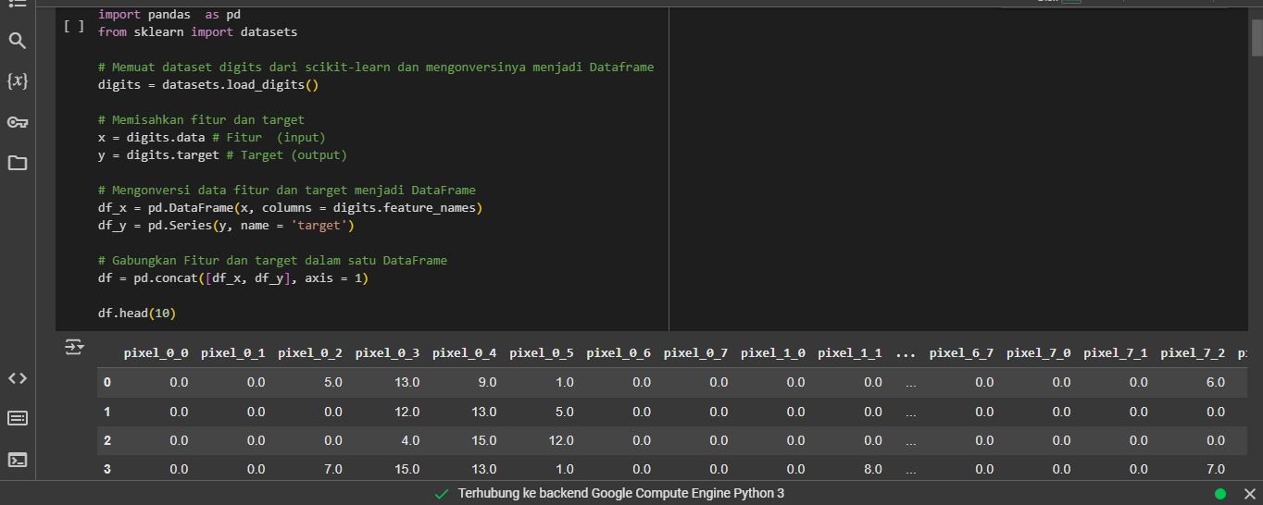
dibimbing.id
Read Dataset

Slide 5
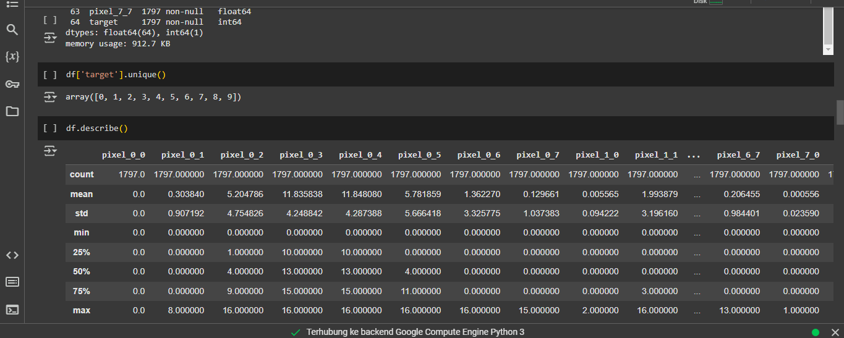
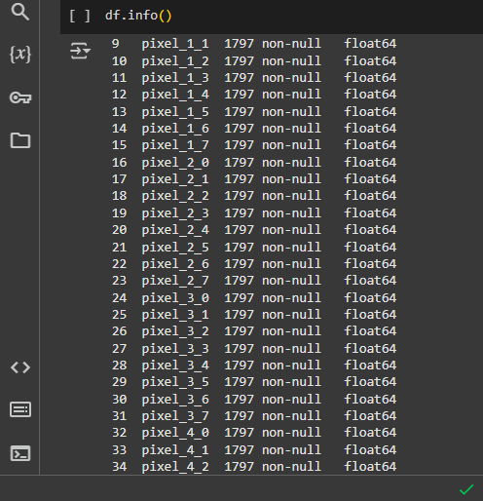
dibimbing.id
Read Dataset

Slide 6
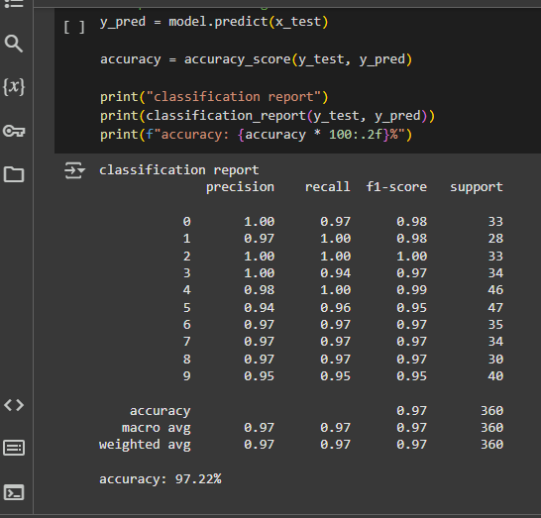
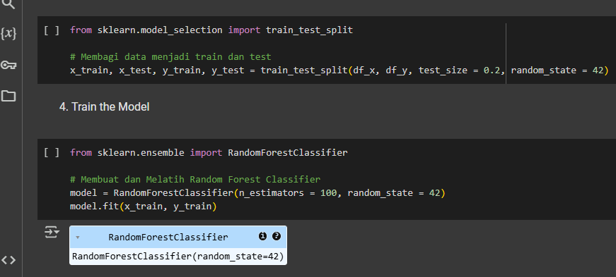
dibimbing.id
Classification Report
Read Dataset
Split Data & Train the Model

Slide 7

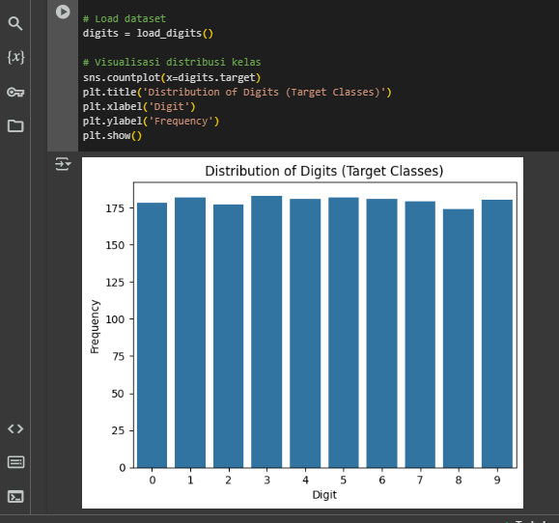
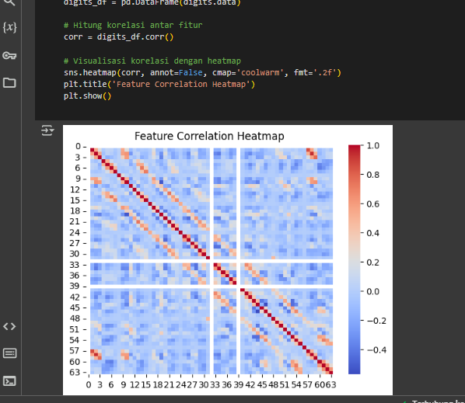
dibimbing.id
DATA VISUALIZATION
Bar Plot
Heatmap

Slide 8
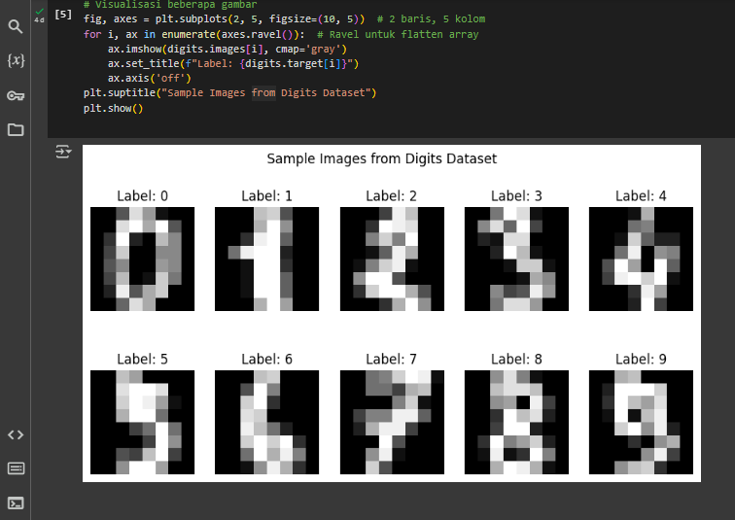
dibimbing.id
DATA VISUALIZATION
Sample Image

Slide 9

dibimbing.id
CONCLUSION
The conclusion from using the "Digits" dataset for classification tasks is that this dataset provides images of handwritten digits (0-9) used to train machine learning models to predict the digits based on the visual features of the images. By building an accurate classification model, such as using algorithms like KNN, SVM, or neural networks, we can classify the images into one of the 10 digit classes. The "Digits" dataset serves as both training and testing data to evaluate the model's performance, with the goal of achieving high accuracy in recognizing handwritten digits.

Slide 10


dibimbing.id
THANK
YOU

